Slide 1


Safe Deal finder
Group4 Dedeepya Vaddi Durgadevi Pampani Sowmya Sree Maddukuri

Slide 2

Introduction
Secure Deal Finder is an e-commerce web application that allows users to compare the prices of products from different platforms while maintaining link, data, and transaction safety. It integrates security and functionality to provide an optimal online shopping experience.

Slide 3
Problem Statement and solution
Problem Statement: Users often receive suspicious product links through WhatsApp, email, or social media claiming 'Get this product for just $100 – limited time!’.Some links are created to steal sensitive data or redirect to scam websites.
Our Solution: We developed a platform that allows users to:
- Check the suspicious URL is safe or not.
- Extract product information if the link is safe from different websites include our own.
- It enables users to Compare prices across trusted stores like amazon,bestbuy,Walmart. This ensures users don’t fall for scams and always get the best deals from verified sources.

Slide 4
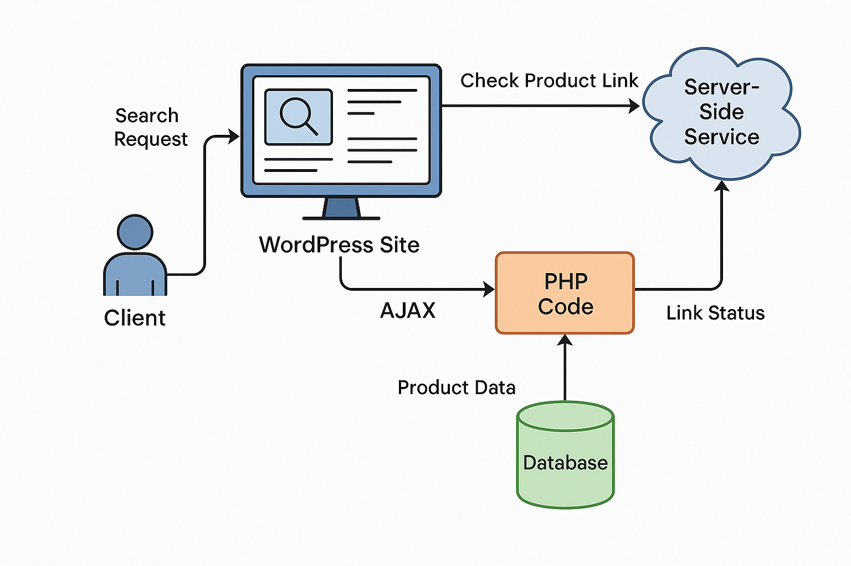
Project Structure Design
Client side :
A client refers to the user’s side browser which they use to access the hosted WordPress website.
How it functions ?
The user can visit the WordPress website which is hosted on GoDaddy.
Using a shortcode in WordPress, they can create a form where they can:
Submit a product link.
Search a for a product by name.
When the Form is submitted:
AJAX is used to submit the request in the background.
The importance of AJAX in this scenario:
Full page reloads are avoided, making the interface smoother and the overall experience a lot more intuitive

Slide 5
Project Structure Design Continued
Server side – (backend + custom PHP) :
In this case, the server is the GoDaddy hosted WordPress backend which contains your logic and processing subsystem.
How it functions in our project?
The client's AJAX call goes to the server
Within your functions.php there’s a PHP code that validates and sanitizes the user input
Calls external APIs:
A safety check of the link is done via Virus Total
ScraperApi gets the title of the product
PriceAPI does the price comparison.
Secure checkout via Stripe can be initiated optionally.
All the processed information is returned to frontend via AJAX response.

Slide 6
Project Structure Design Continued
Database (WordPress MySQL DB):
The MySQL database containing all information associated with the WordPress application.
Usage of it in our project:
Stores:
User login information
Settings for plugins
Content of a shortcode
Logs or entries (if enabled through plugins)
We did not create custom database tables — everything is managed through Wordpress.

Slide 7
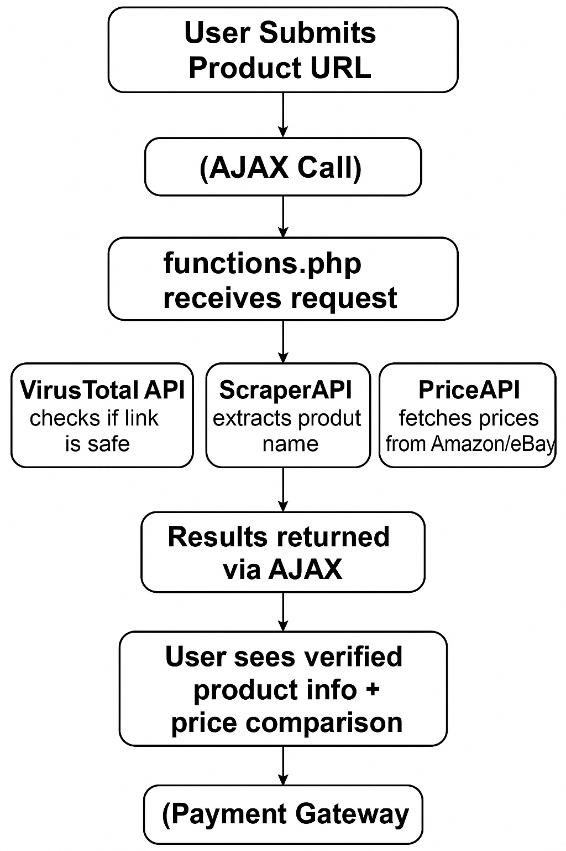
Data Flow Diagram
Customer Interaction:
The end user either provides a product URL or utilizes a search or filter option from the website interface.
AJAX Call:
An AJAX call sends information to the WordPress backend and updating the page without refreshing it.
Security Verification:
The backend uses the provided URL and performs a check using the VirusTotal API to see if the link is phishing or malicious.
Data Extraction and Comparison Pricing:
In case the link is okay;
ScraperAPI jumps into action and retrieves the product description.
PriceAPI checks the product's price on major platforms like Amazon, eBay, BestBuy and others.

Slide 8
Data Flow Diagram continued..
Payment Gateway Integration:
If the user decides to proceed with purchasing, secure payment is processed through Stripe or PayPal.
User Response:
The AJAX powered UI shows the user the relevant product details including pricing and available purchase options, which they can effortlessly select through an authenticated purchase option.
MySQL Database Logging:
The System keeps track of all interactions from URL submissions to and user activity for analytic purposes.

Slide 9
Results and Analysis
Achievements and Outcomes:
Able to successfully integrate two factor authentication using HOTP as an additional layer of security.
Secure connection is established via SSL Certificates.
Successfully developed a secure website capable of detecting and rejecting spam or phishing URLs.
Product scrapping from unknown links and then get the details of product from trusted sources.
Implemented secure payment systems.
Conducted vulnerability assessment using wapiti tool to know vulnerabilities of our site.

Slide 10
Results and Analysis
Vulnerability Assessment :
We have scanned for vulnerabilities in our website using wapiti as our primary tool.
We have done a vulnerability assessment on our wordpress based site: http://190.7ee.myftpupload.com
Wapiti detects web application vulnerabilities such as:
SQL Injection
Cross Site Scripting(XSS)
Command execution
Insecure cookie and other missing headers
No serious vulnerabilities like SQLi, XSS or CSRF were able to be detected.
Several HTTP security headers were absent at the beginning.
Most of them were fixed after implementing the Headers Security Advanced and HSTS WP plugin.

Slide 11
Conclusion
We created a functional and secure website that filters out spam or phishing product links to protect users from scams. With the help of the APIs provided by VirusTotal, ScraperAPI, and PriceAPI, the site cross-checks the product information it gathers from untrusted links with reliable sources like Amazon and Best Buy. Security testing in Wapiti helped us resolve problems such as omissions of HTTP headers which made the site less secure. This project demonstrates the integration of WordPress and external APIs for developing an intelligent and secure online shopping website.

Slide 12
References
VirusTotal Developers. (n.d.). VirusTotal API v3 Reference. Retrieved from https://developers.virustotal.com/referenceScraperAPI. (n.d.).
Web scraping API for developers. Retrieved from https://www.scraperapi.comPriceAPI. (n.d.).
Product price comparison API. Retrieved from https://www.priceapi.com
OWASP. (n.d.). HTTP Security Headers (Protection for Browsers). Retrieved from https://owasp.org/www-project-secure-headers/

